Slide 1

Airbnb Predicting
Isabel Z. Vinicius S. Drake P. Tyler L.

Slide 2

Problem Statement
Airbnb prices vary widely in the city of New York, depending on location.
Real Estate estimation.
Market Trends

Slide 3
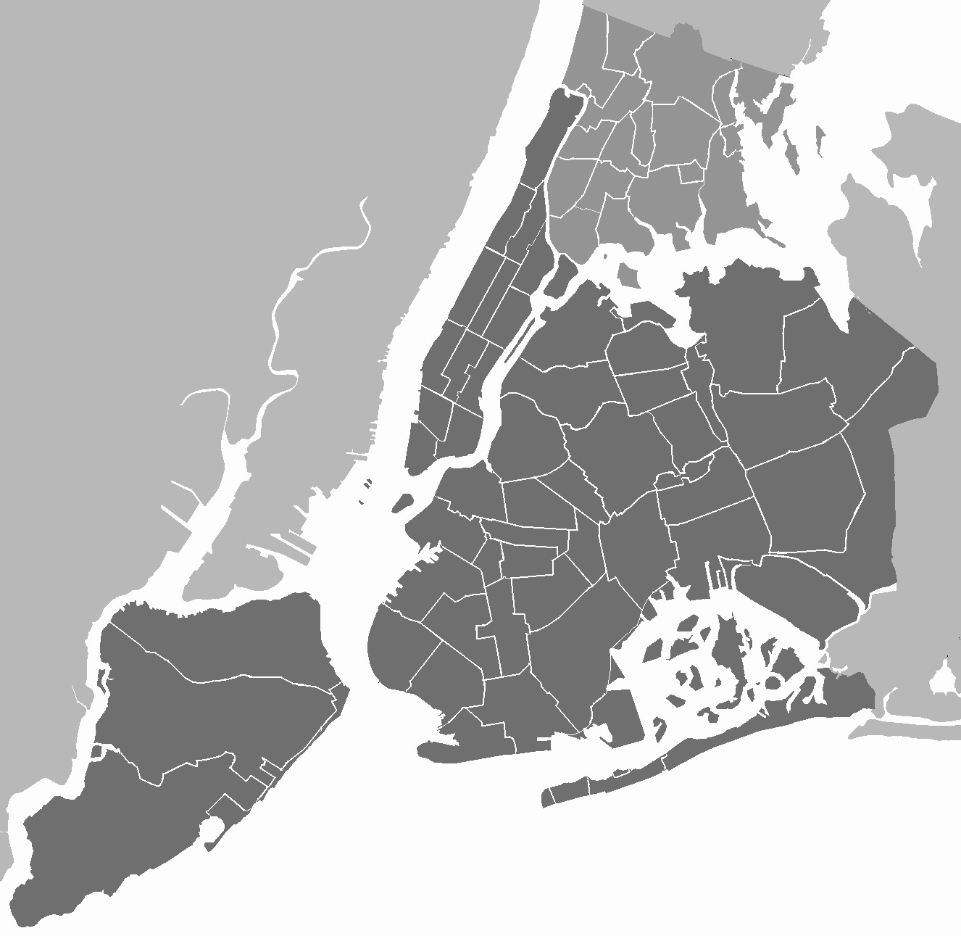
The Data
12 Attributes
47.5 K Instances
5.2MB
Advantages:
Varied
Useful Attributes
Fairly large

Slide 4
The Process
Clean
Visualize
Prepare for ML
Fine Tune
Train
Select Model
Test
Analyze
Deliver

Slide 5
Machine Learning Techniques
Linear Regression
Clustering
Random Forest
Effective
Simple
Scenario Appropriate
Powerful
Accurate

Slide 6
Progress
Rearranging Data
Linear Regression
Random Forest
Removal
Outliers
Simple Regression
Working

Slide 7
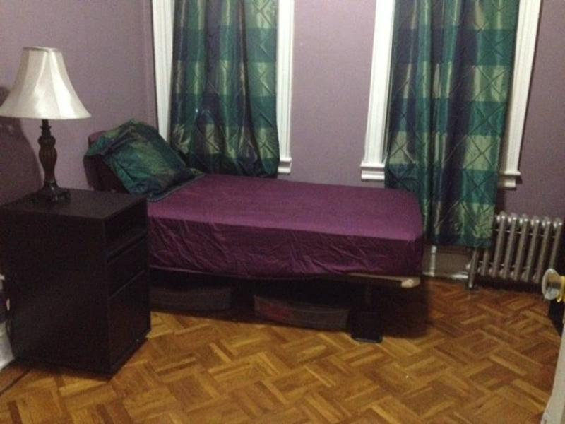
Progress
Rearranging Data
Linear Regression
Random Forest
Removal
Outliers
Simple Regression
Working

Slide 8
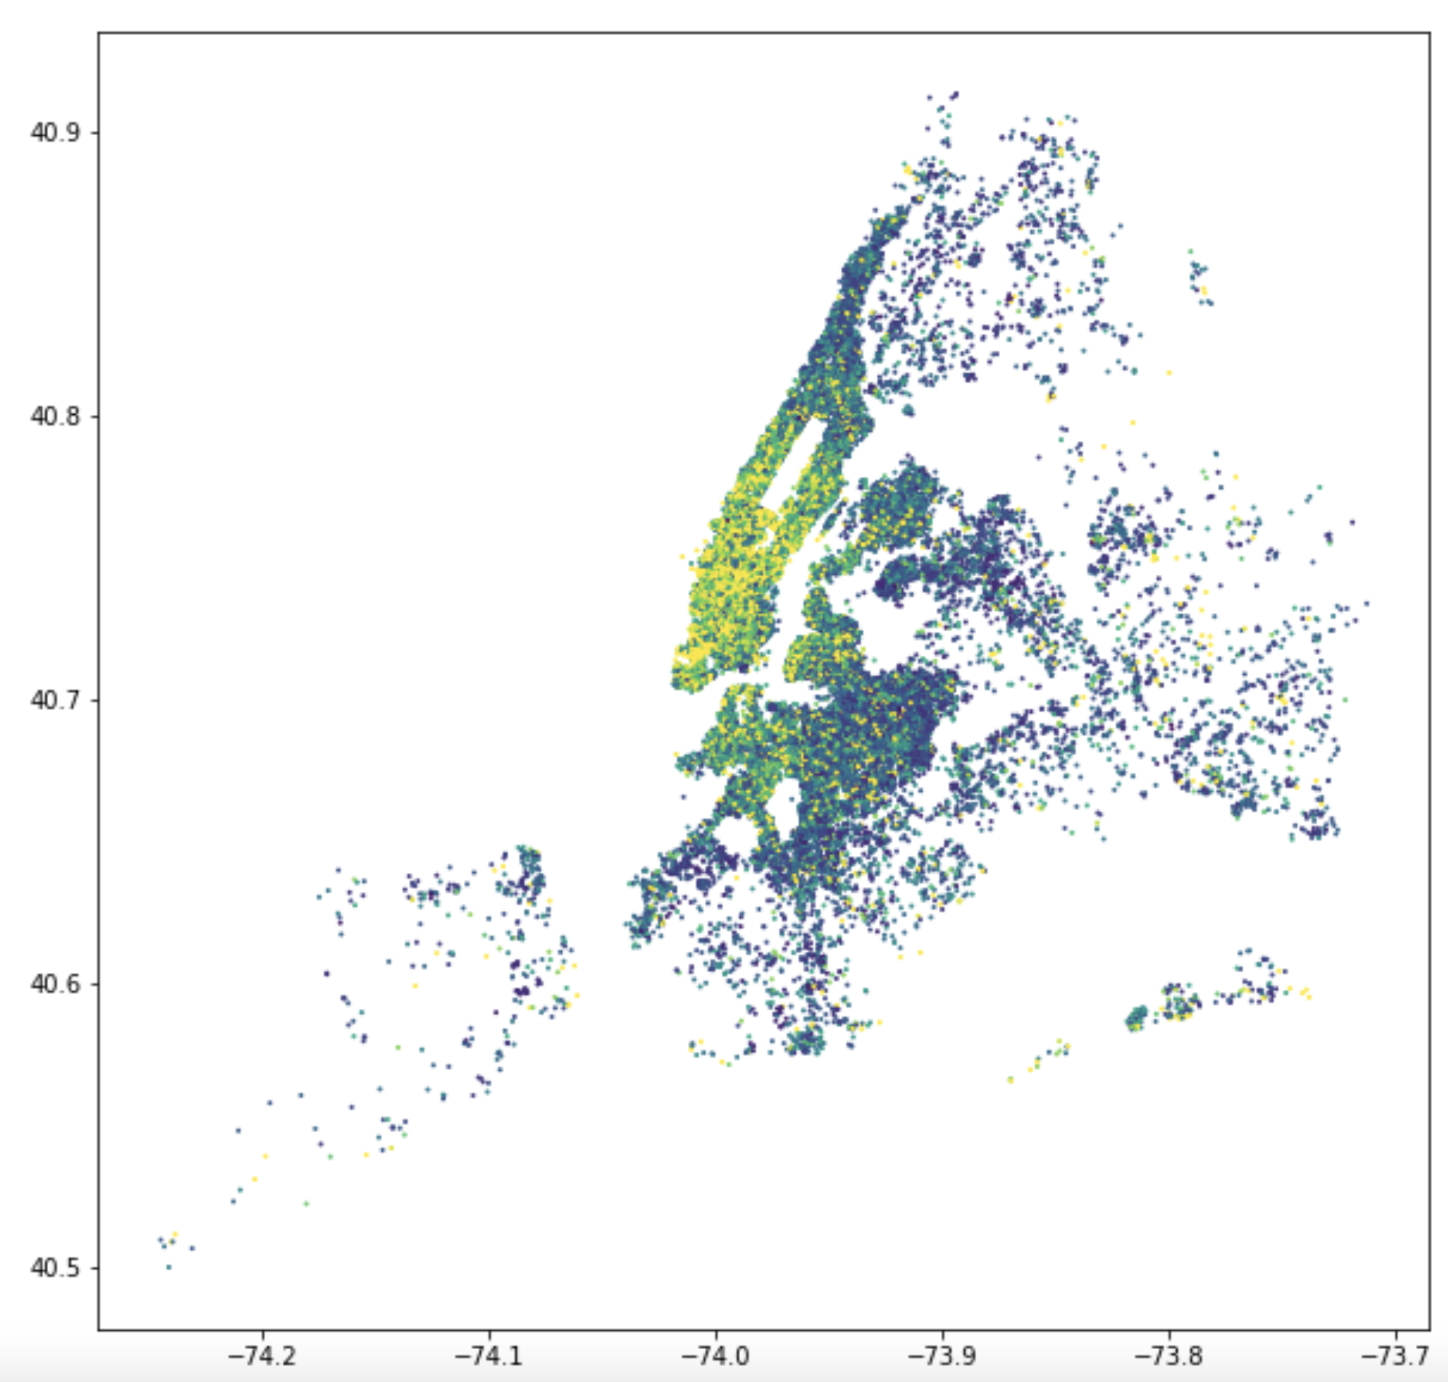

Slide 9
Analysis
Goal: 90% accuracy predictions.
Attributes used.
Usefulness.
Outliers / Issues.

